Slide 1
流体力学课程研讨题目

Slide 2
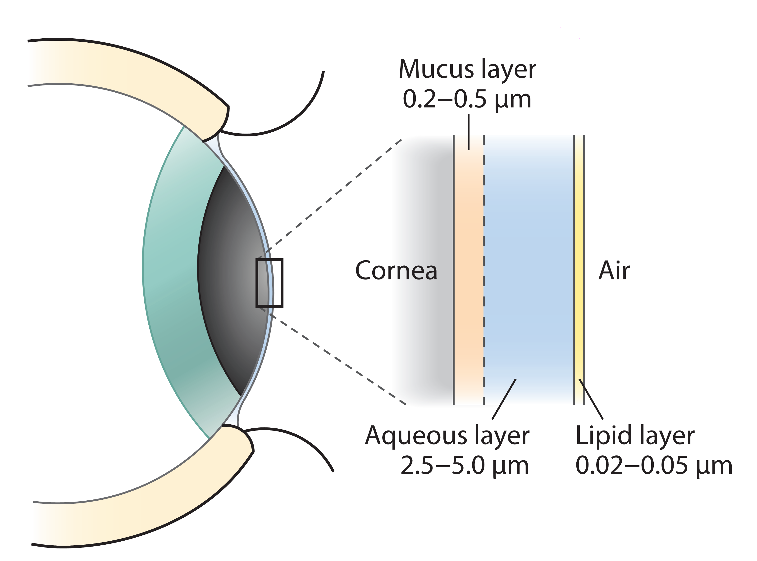
Dynamics of the Tear Film
粘液层
眼角膜
水层
脂质层
Braun R J, 2012, Annual Review of Fluid Mechanics, 44: 267-97.

Slide 3
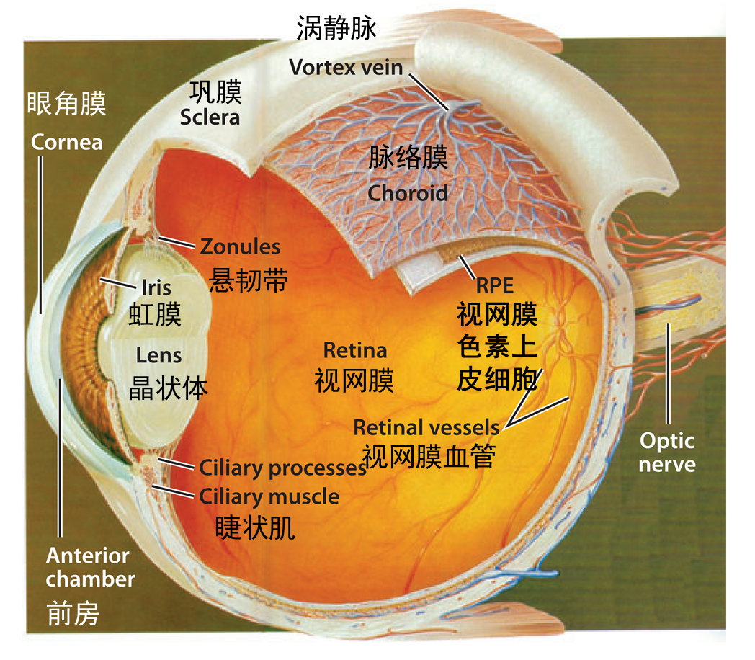
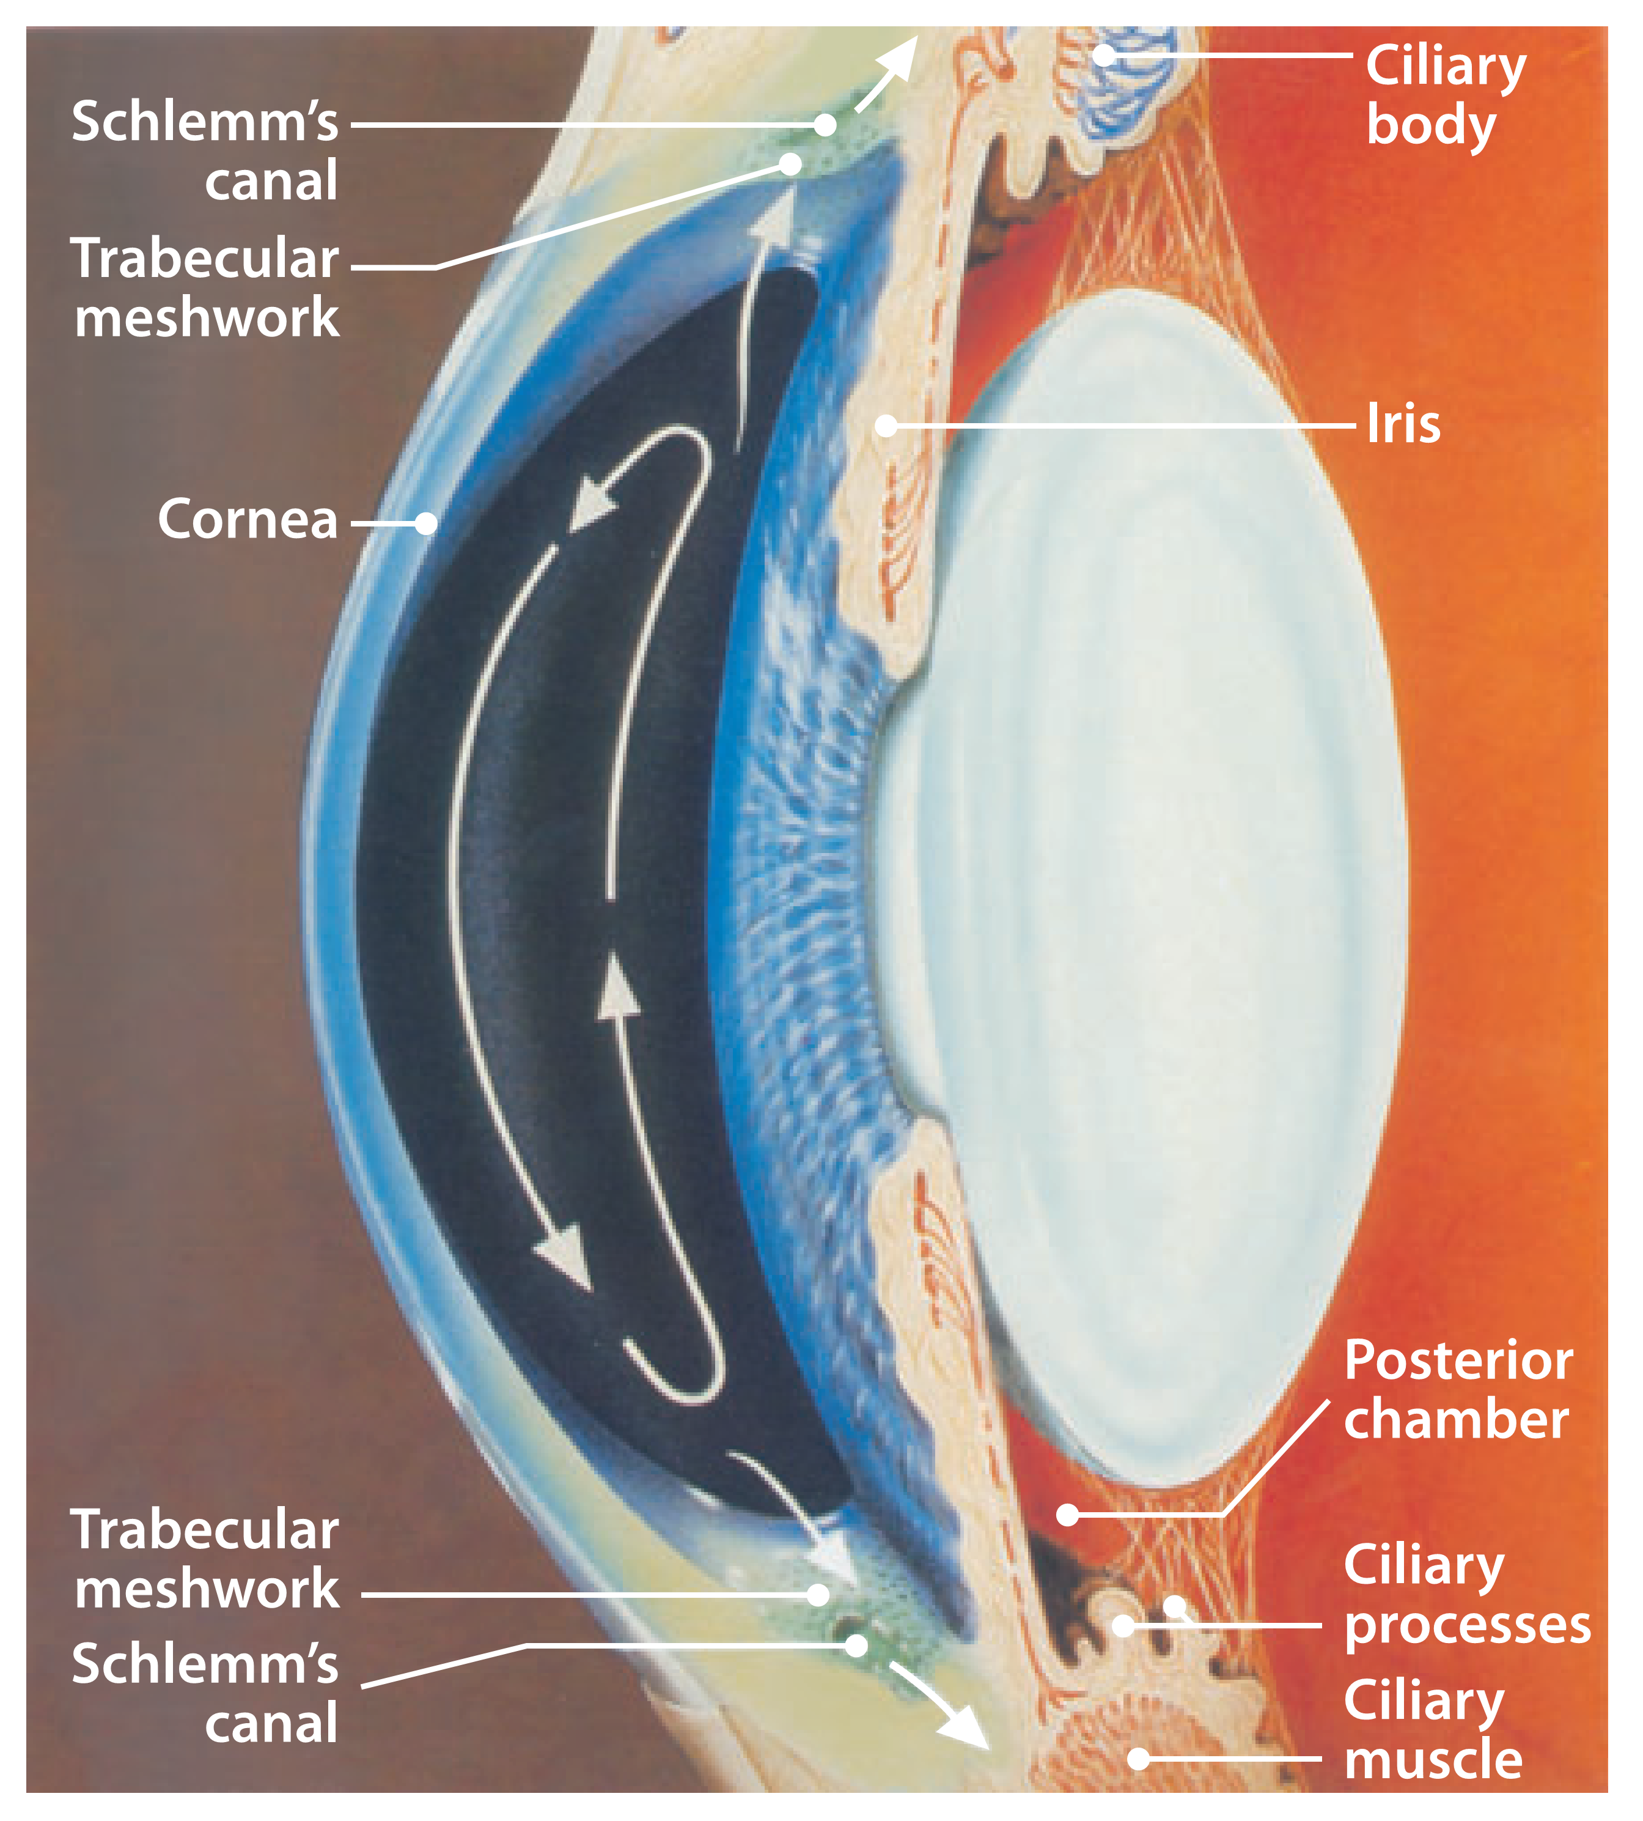
Fluid Mechanics of the Eye
Siggers JH, Ethier CR, 2012, Annual Review of Fluid Mechanics, 44: 347-72.

Slide 4
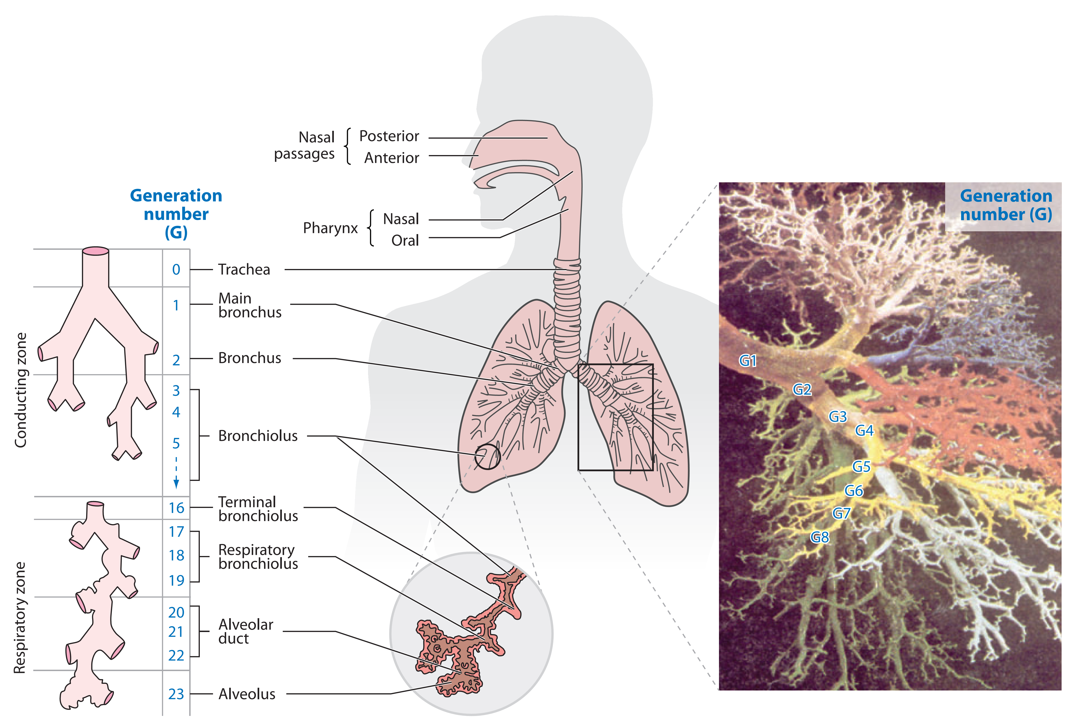
Airflow and Particle Transport in the Human Respiratory System
C. Kleinstreuer and Z. Zhang, Annu. Rev. Fluid Mech. 2010. 42:301–34

Slide 5
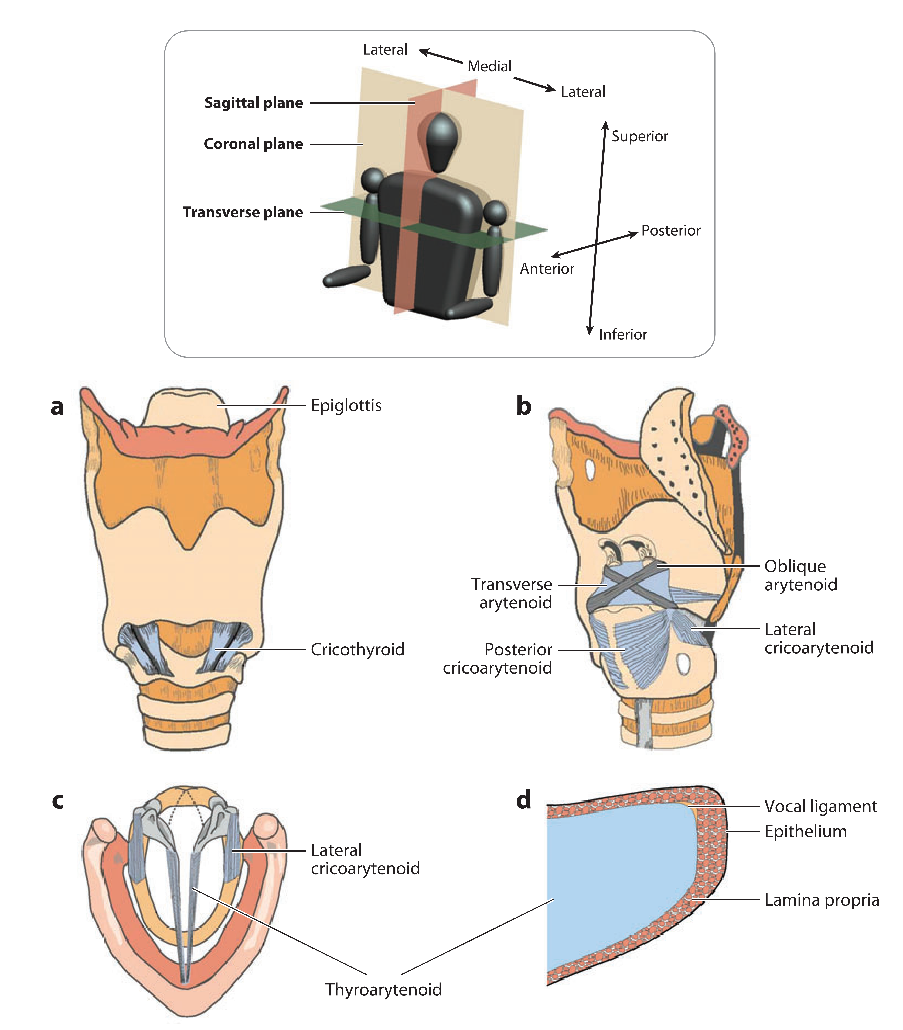
Fluid Dynamics of Human Phonation and Speech
Annu. Rev. Fluid Mech. 2013. 45:437–67

Slide 6
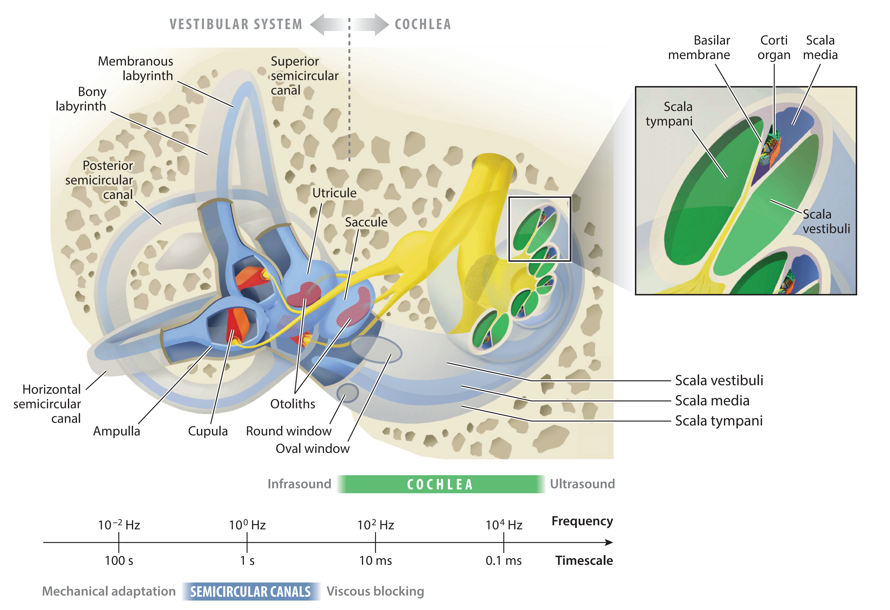
Flow Phenomena in the Inner Ear
Annu. Rev. Fluid Mech. 2019. 51:487–510

Slide 7
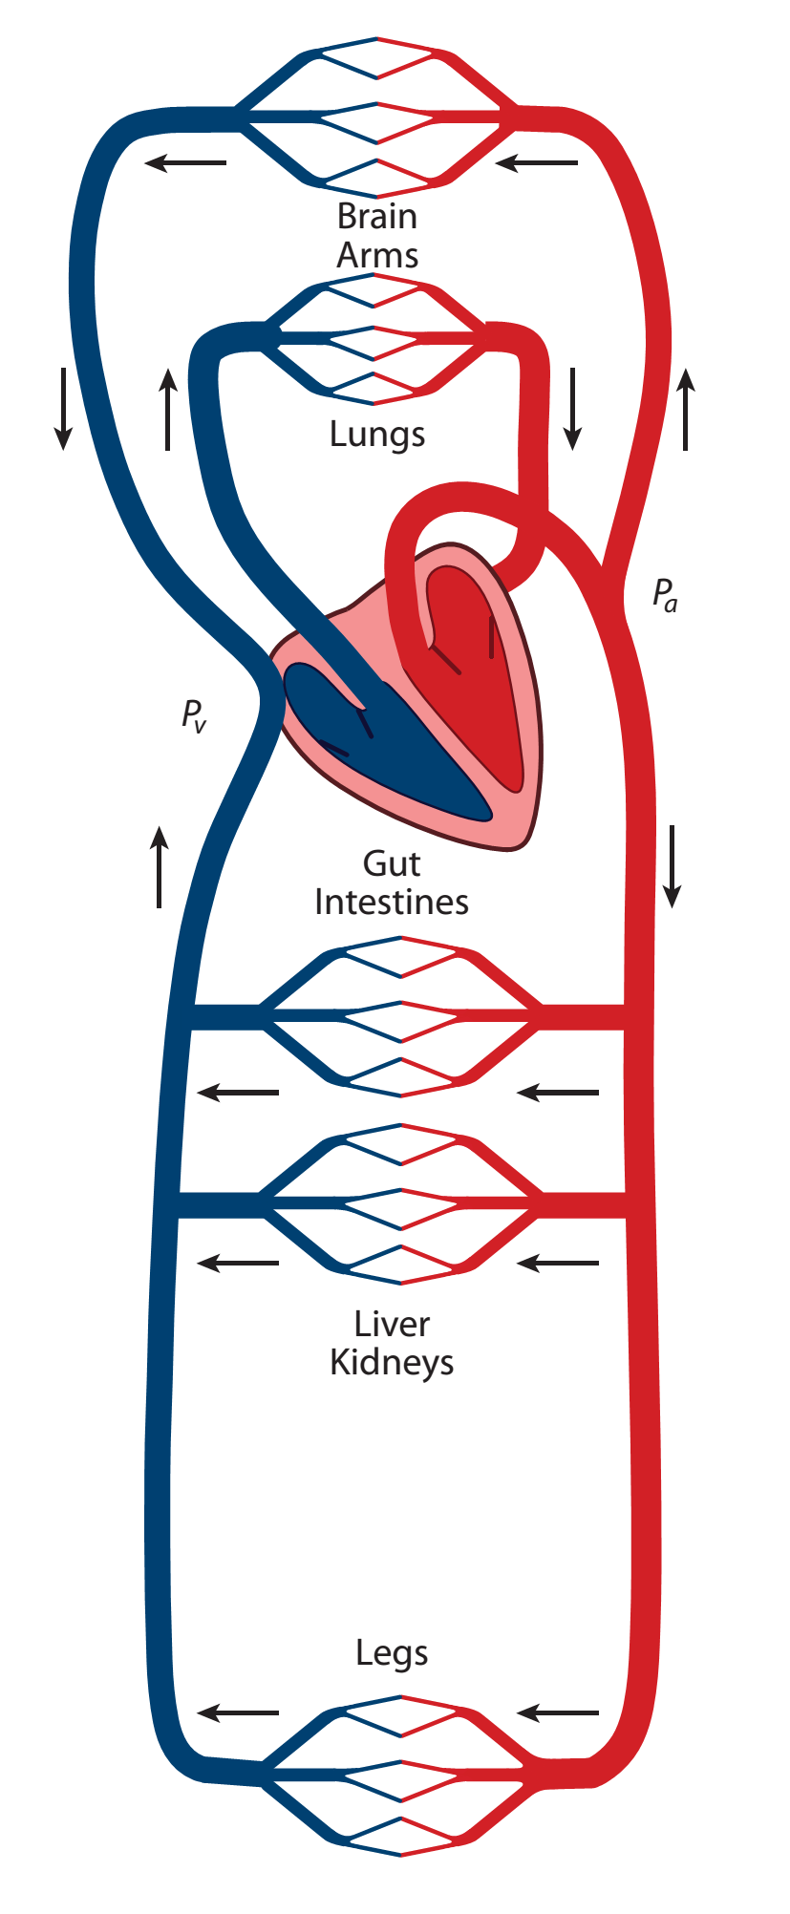
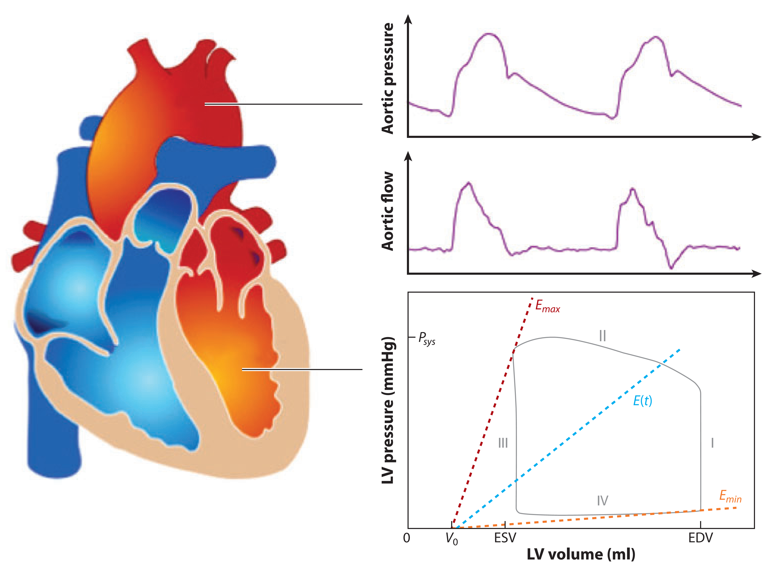
Pulse Wave Propagation in the Arterial Tree
van de Vosse F N, Stergiopulos N, 2011, Annu. Rev. Fluid Mech., 43: 467-99

Slide 8
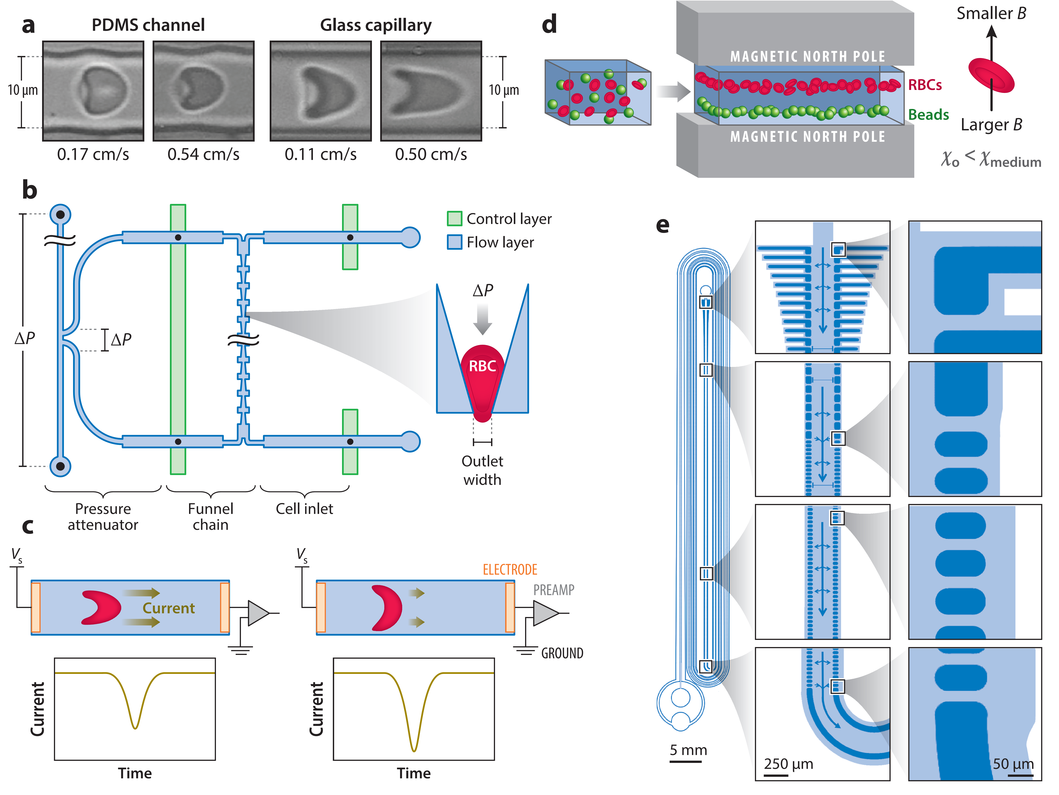
Microfluidics to Mimic Blood Flow in Health and Disease
Annu. Rev. Fluid Mech. 2018. 50:483–504

Slide 9
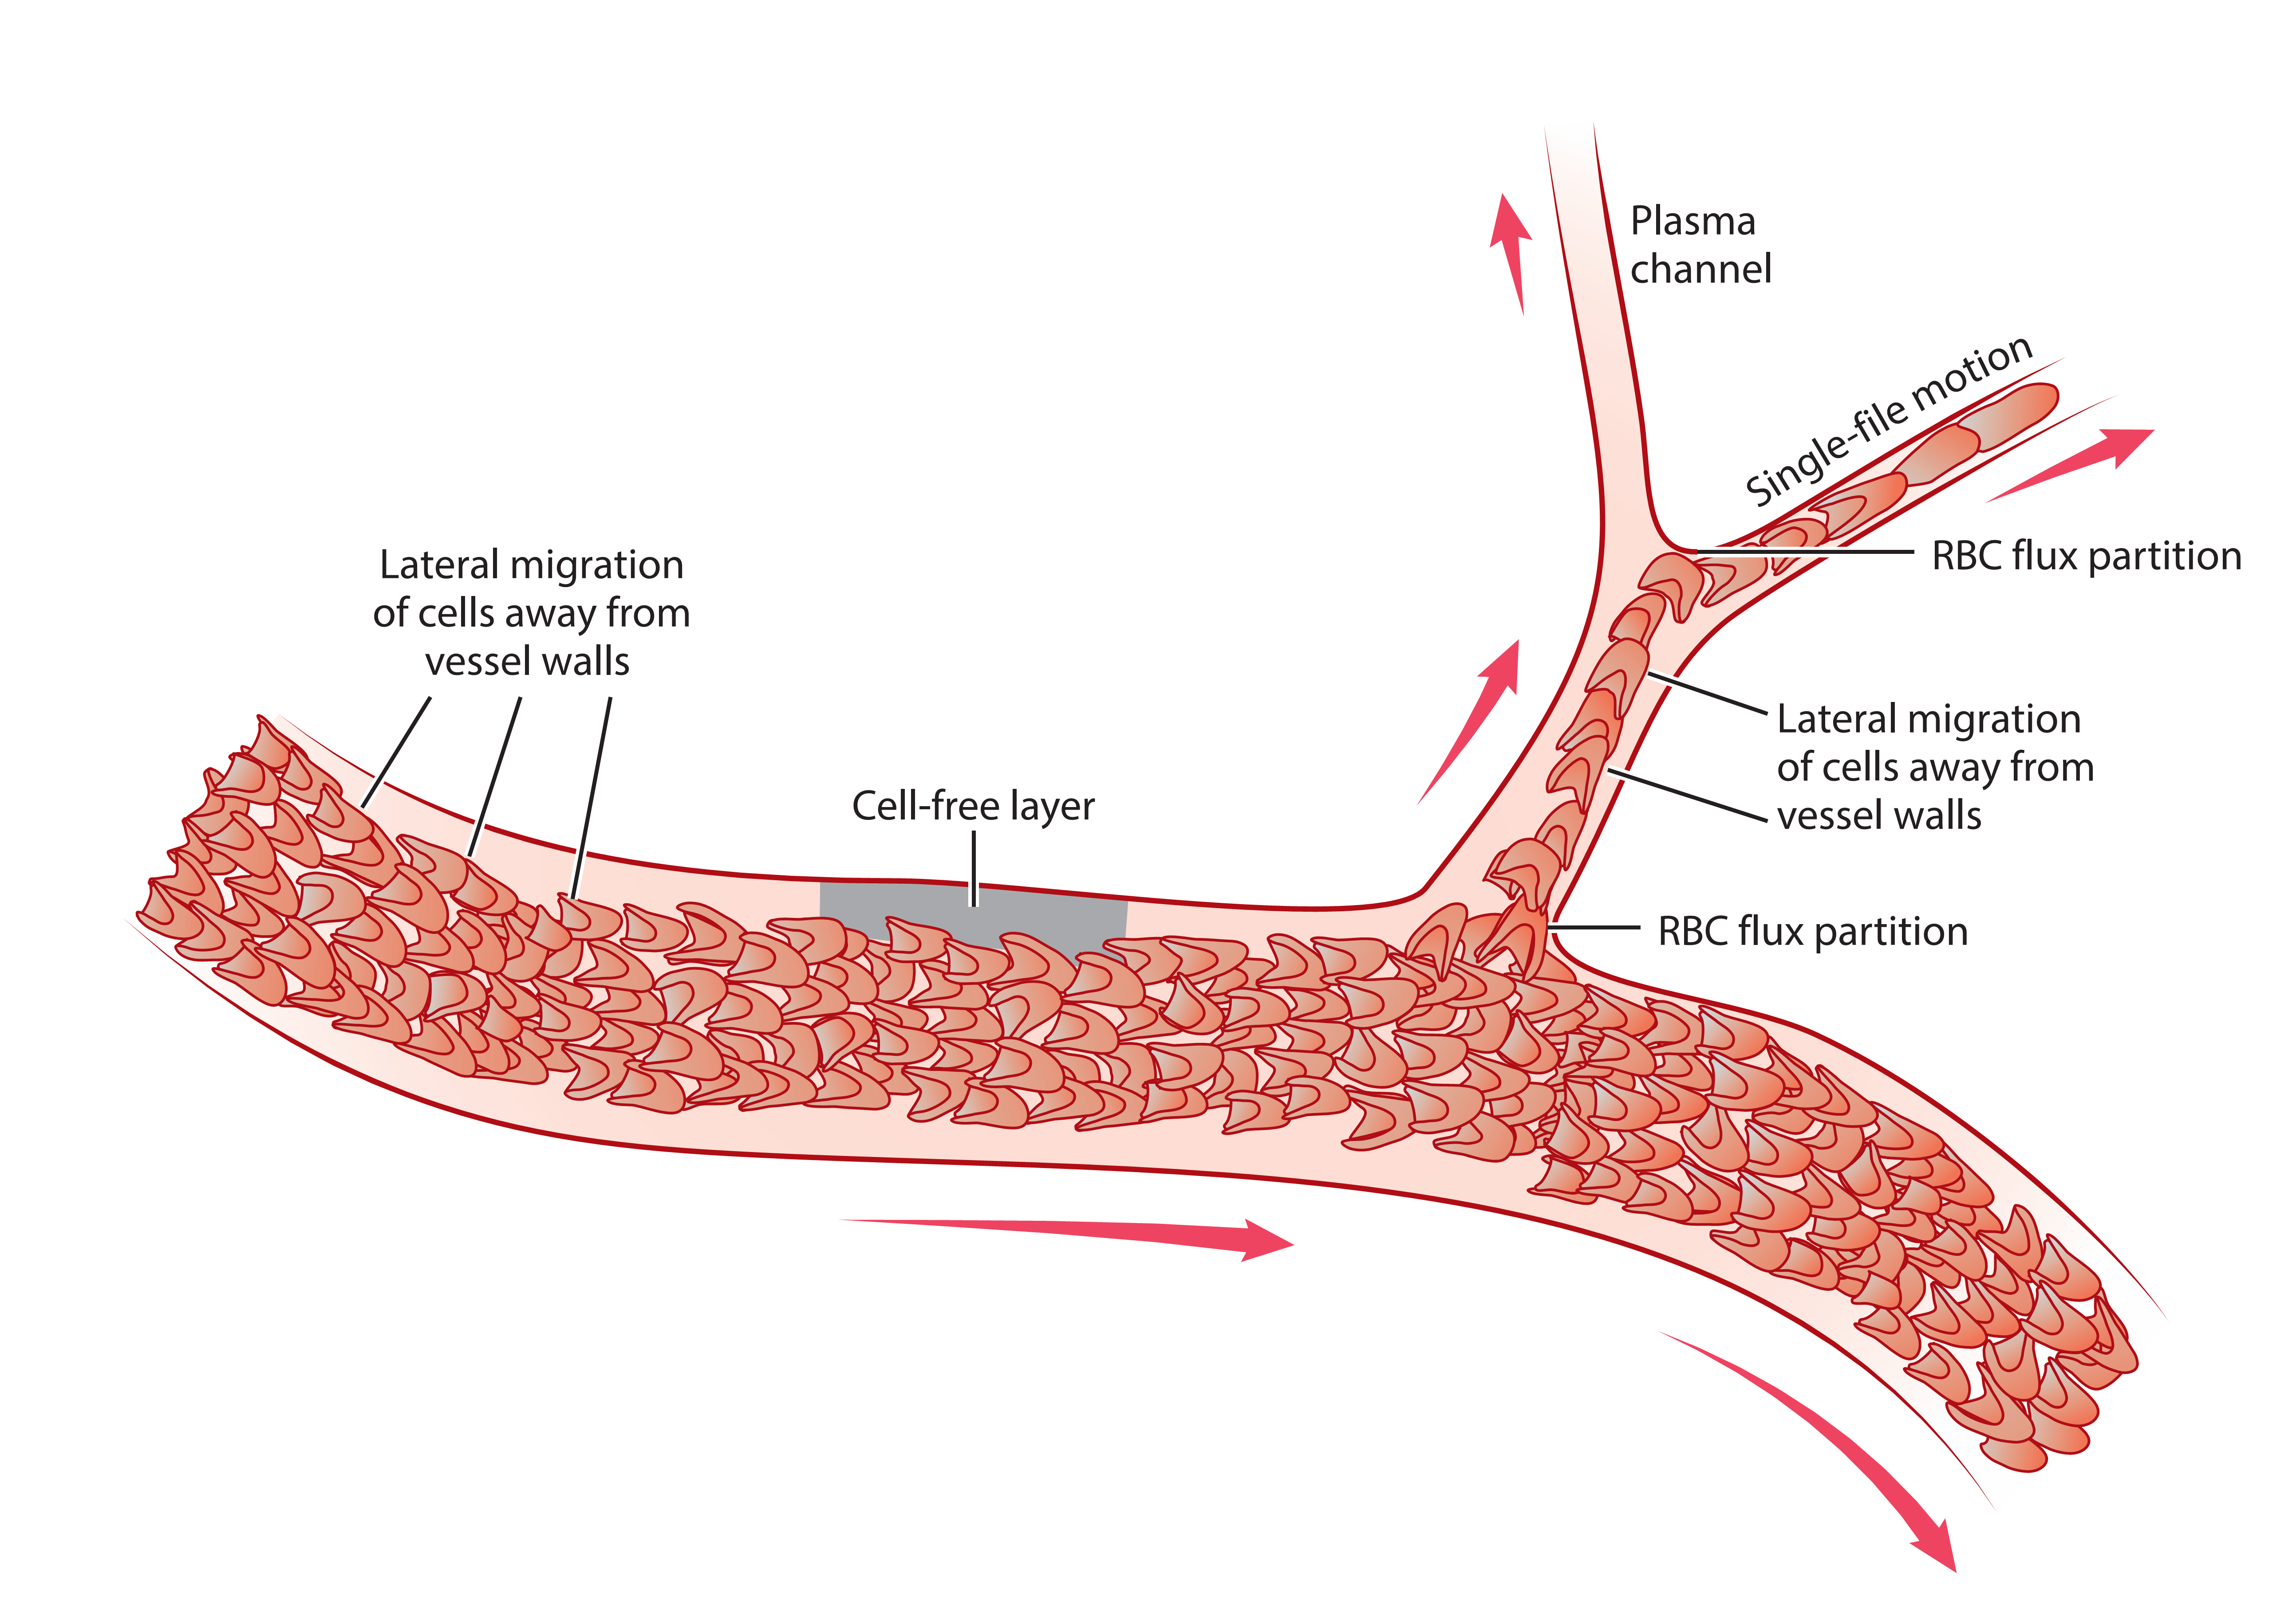
Blood Flow in the Microcirculation
Annu. Rev. Fluid Mech. 2017. 49:443–61

Slide 10
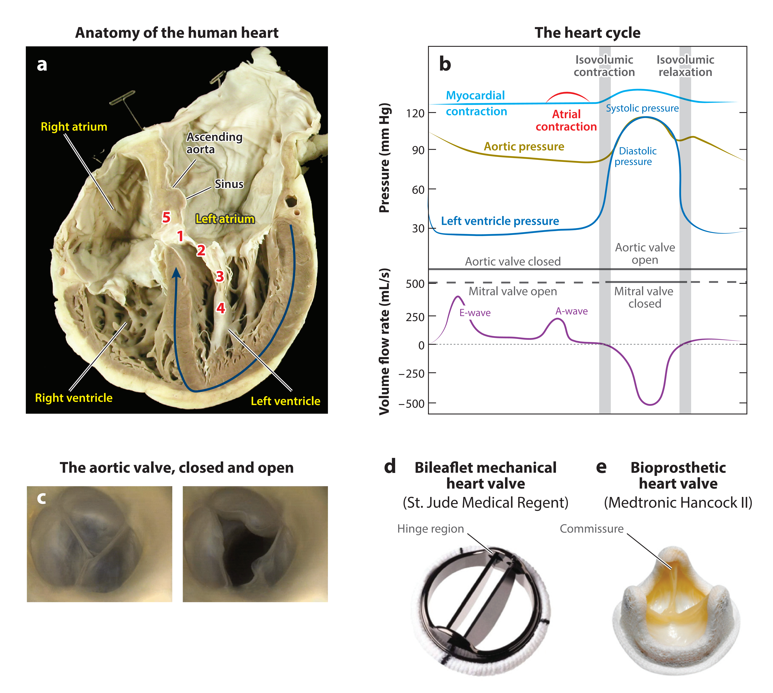
Fluid Mechanics of Heart Valves and Their Replacements
Annu. Rev. Fluid Mech. 2016. 48:259–83

Slide 11
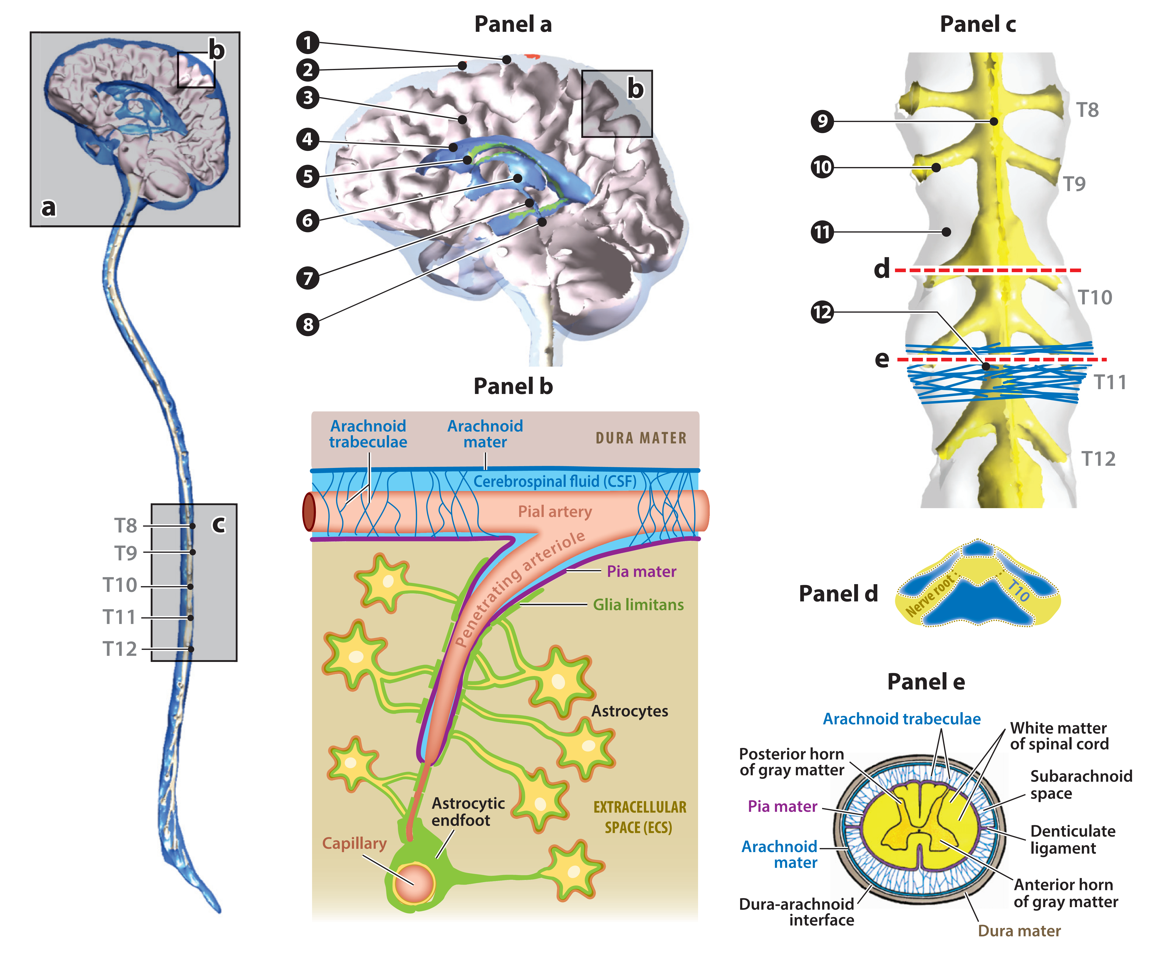
Cerebrospinal Fluid Mechanics
Linninger AA, Tangen K, Hsu CY, Frim D, Annu. Rev. Fluid Mech. 2016. 48:219–57

Slide 12
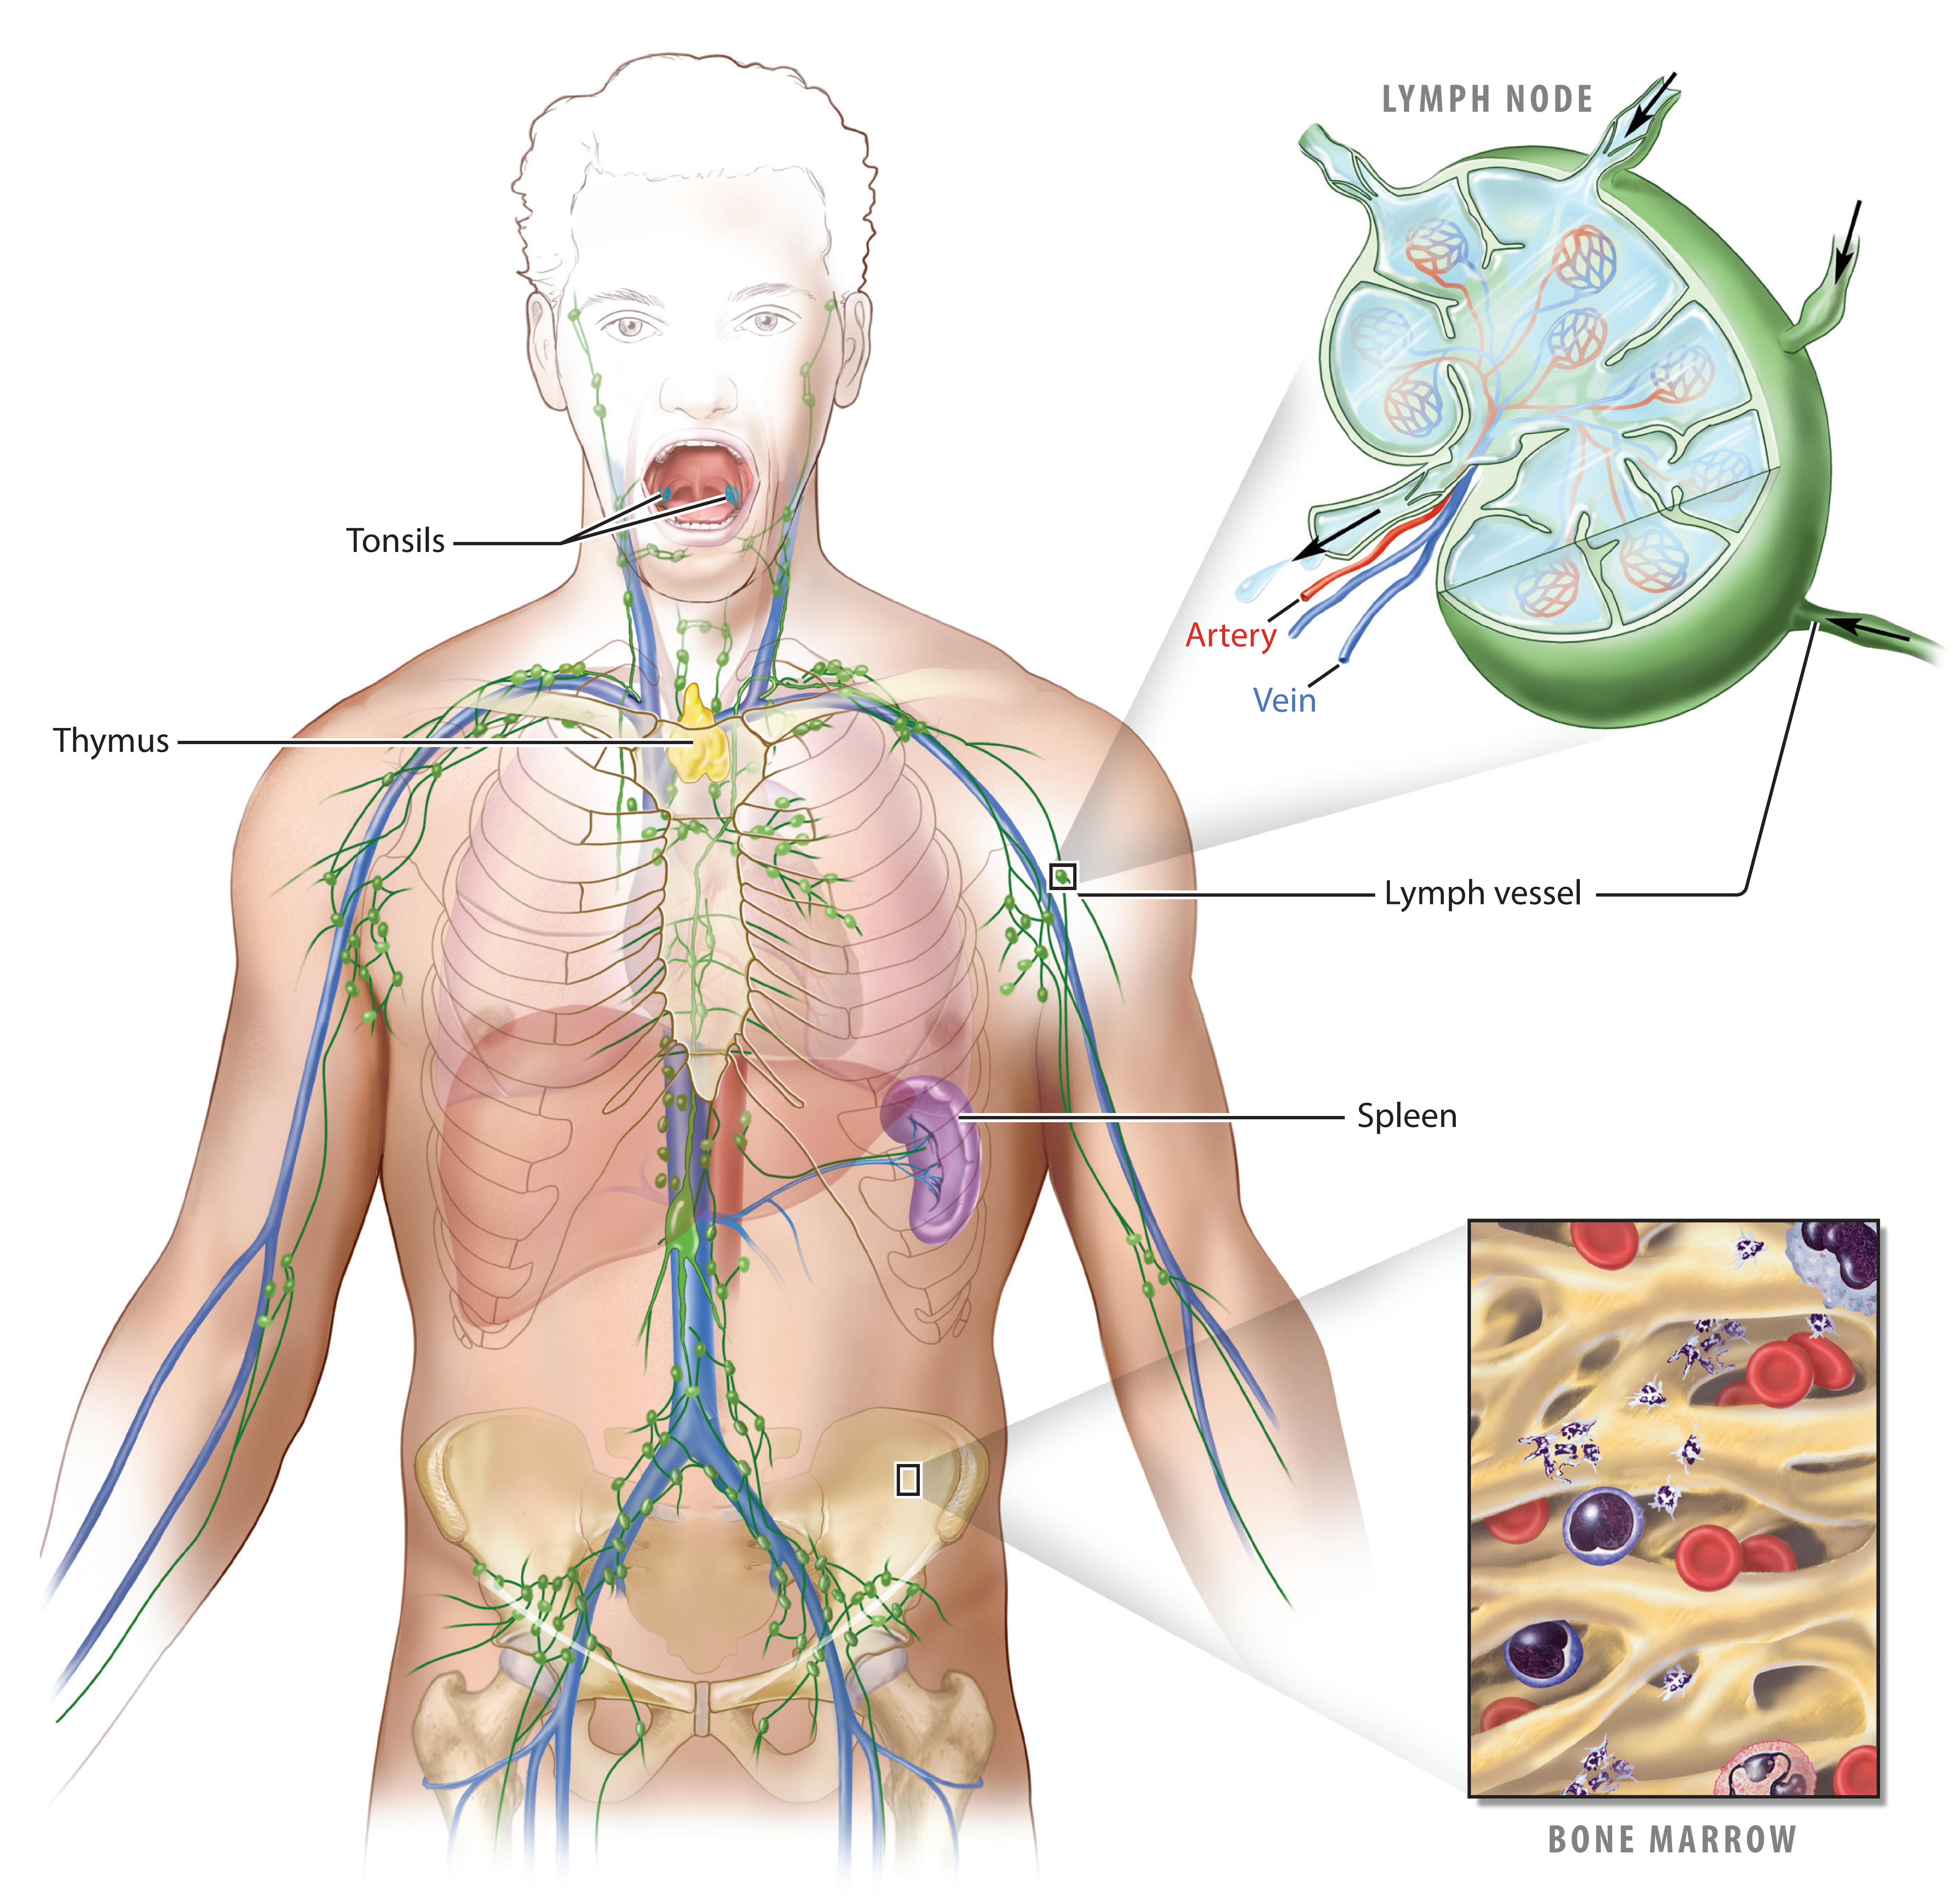
Lymphatic System Flows
Annu. Rev. Fluid Mech. 2018. 50:459–82

Slide 13
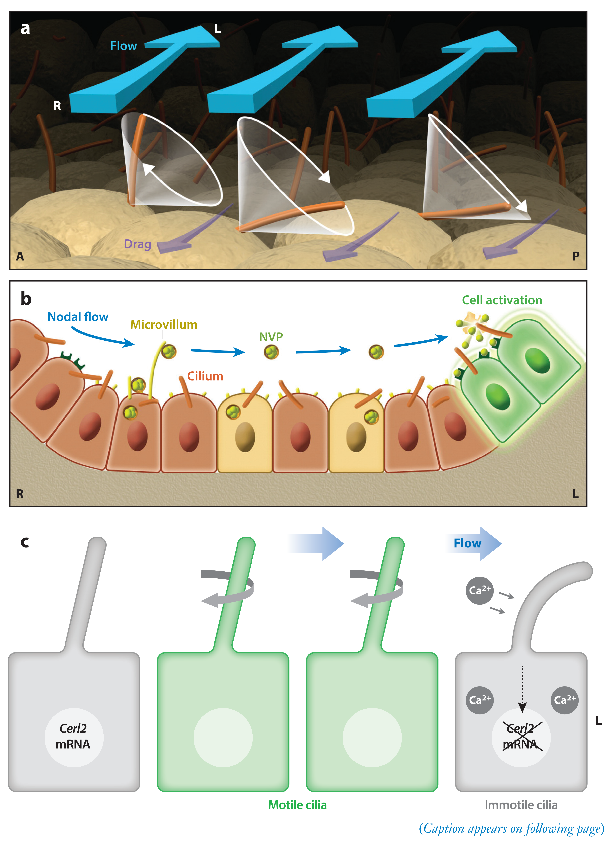
Symmetry-Breaking Cilia-Driven Flow in Embryogenesis
Annu. Rev. Fluid Mech. 2019. 51:105–28

Slide 14
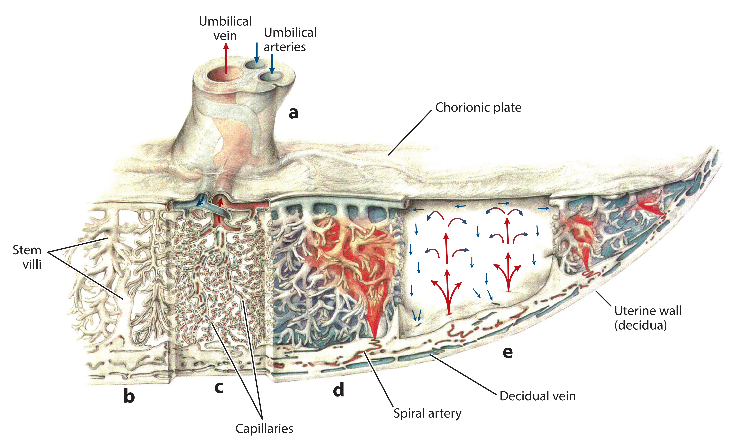
Blood Flow and Transport in the Human Placenta
Annu. Rev. Fluid Mech. 2019. 51:25–47

Slide 15
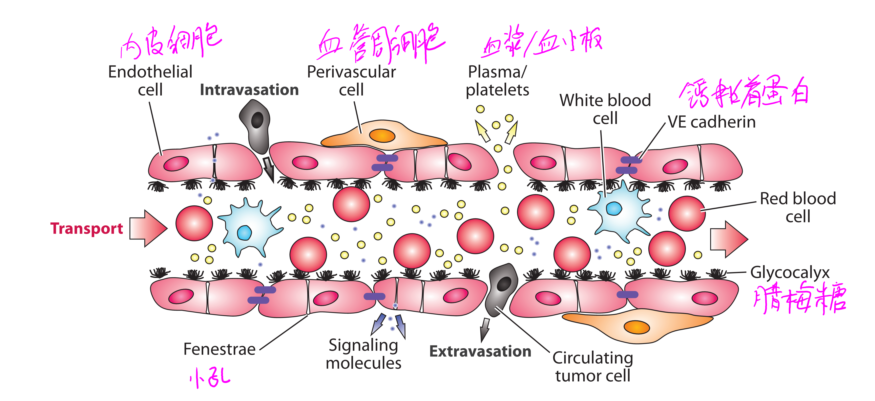
The Fluid Mechanics of Cancer and Its Therapy
Koumoutsakos P, Pivkin I, Milde F, Annu. Rev. Fluid Mech. 2013. 45:325–55

